Slide 1
A Quick Primer on TensorFrames Apache Spark and TensorFlow Together
Tom Drabas
Data Scientist II
Denny Lee
Principal Program Manager

Slide 2
Session Goals
What is Deep Learning?
A primer on feature learning
What is feature engineering?
What is TensorFlow?
Build a Deep Learning model to recognize objects in images
Introducing TensorFrames
TensorFrames – quick start

Slide 3
Tom Drabas Data Scientist II, Core Data Science (WDG)
All-around geek and nerd
Close to 15 years of industry experience: analytics, operations research and data science.
Worked in airlines, telecommunications, logistics and technology
Interested in big data, algorithms, neural networks, and… vintage electronics

Slide 4
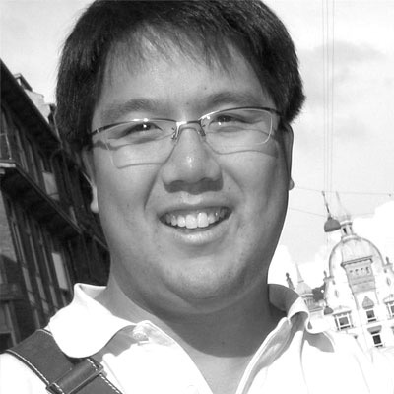
Denny Lee Principal Program Manager, Azure Cosmos DB
Former:
Technology Evangelist @ Databricks
Senior Director of Data Sciences Engineering at Concur (now part of SAP)
Principal Program Manager at Microsoft
Hands-on Data Engineer, Architect more than 15y developer internet-scale infrastructure for both on-premises and cloud including Bing’s Audience Insights, Yahoo’s 24TB SSAS cube, and Isotope Incubation Team (HDInsight).

Slide 5
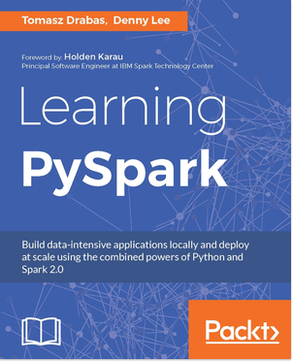
Jump Start into Python and Apache Spark

Slide 6
Many Thanks!
Tim Hunter – Databricks: TensorFlow / TensorFrames Guru

Slide 7
Prerequisties

Slide 8
Tutorial Prerequisites
Python (Anaconda) or
Databricks Community Edition
https://databricks.com/try-databricks

Slide 9
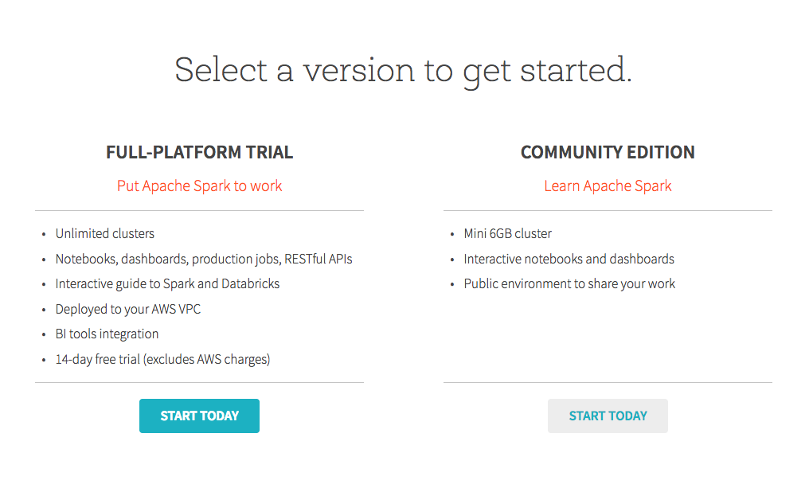
Get Databricks Community Edition
http://databricks.com/try-databricks

Slide 10
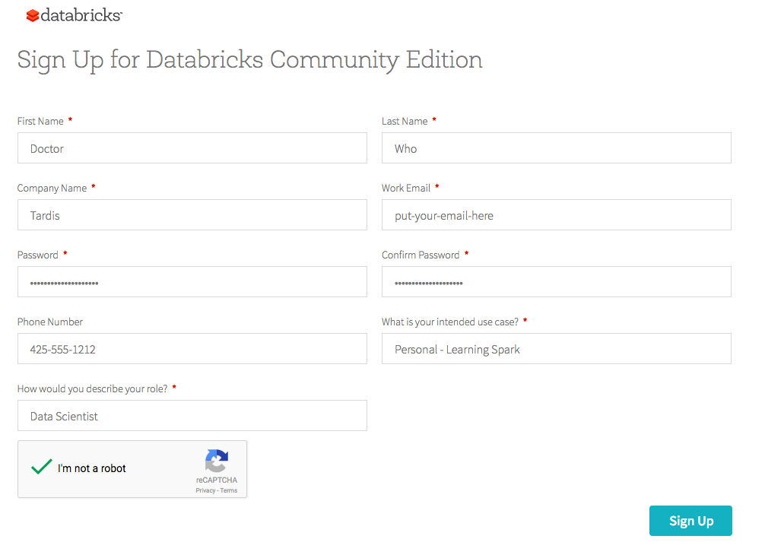
Sign Up for Databricks Community Edition

Slide 11

Confirm your email address

Slide 12

Sign in!
https://community.cloud.databricks.com

Slide 13
What are artificial neural networks?

Slide 14
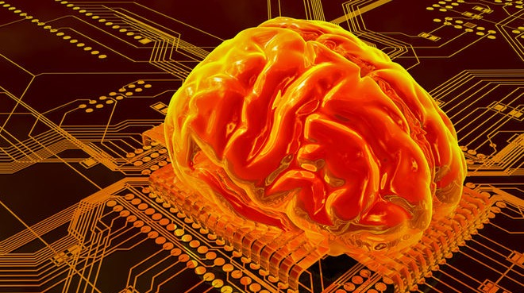
Artificial Neural Networks
source: http://bit.ly/2jjzFyt

Slide 15
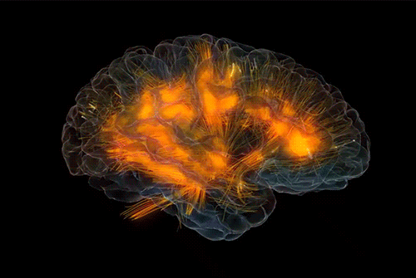
An imitation of human’s brain
Dense net of simple structures
Around 100 billion neurons
Each connected to ~10k other neurons
10¹⁵ synaptic connections
source: http://bit.ly/2jc9mYw

Slide 16
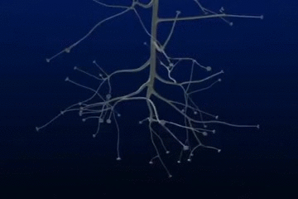
A neuron at work
Dendrites receive signals
Neuron’s cell body acts as an accumulator
If energy level in the neuron’s body exceeds certain level it fires a short pulse through the axon ended with synaptic terminals
source: http://bit.ly/2jjGlNd

Slide 17
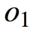
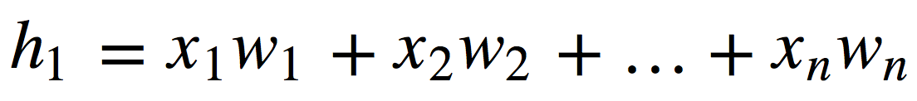
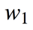
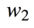
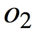
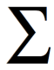
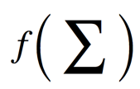
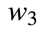
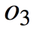
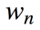
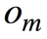
Conceptual mathematical model
Receives input from n sources
Computes weighted sum
Passes through an activation function
Sends the signal to m succeeding neurons

Slide 18
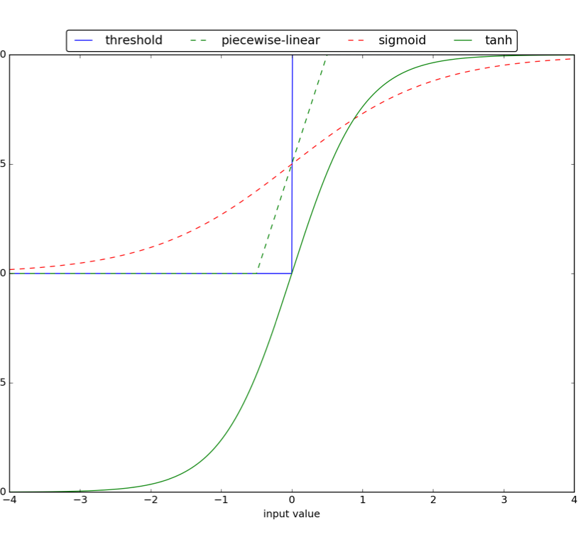
Activation functions
Bias (threshold) activation function was proposed first
Sigmoid and tanh introduce non-linearity with different codomains

Slide 19
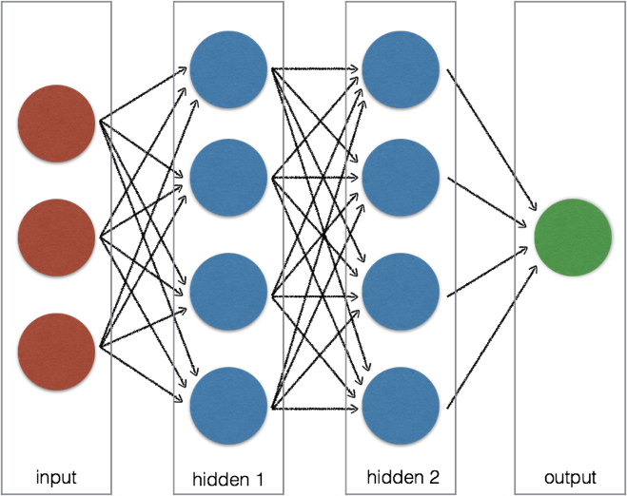
Artificial Neural Network
A layer is a set of neurons
Typically consists of input, hidden and output layers
Input layer acts as an interface
The neurons in hidden layer(s) and the output modify data
A black-box model

Slide 20
Types of neural networks
Image sources linked
Some examples
Single- or multi-layer
feedforward networks
Radial Basis Function
Recurrent Neural Networks

Slide 21
Learning
Image sources linked
Some examples
Backpropagation
Memory based learning
Self-organizing maps (competitive learning)

Slide 22
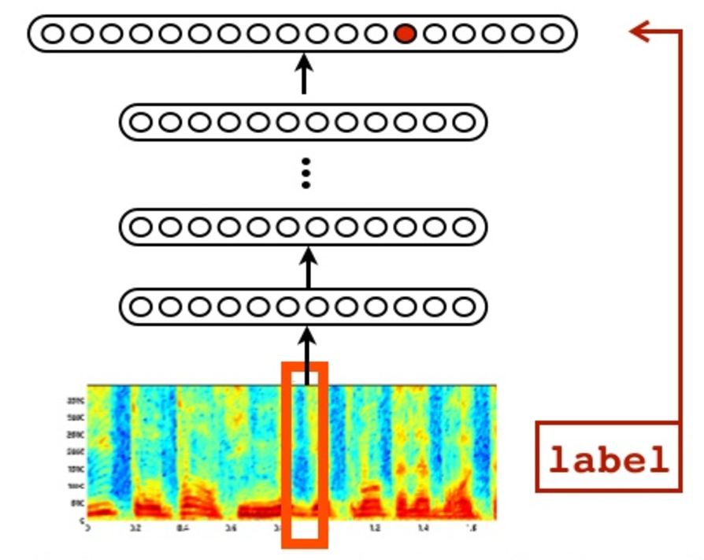
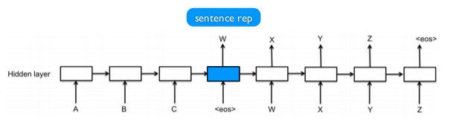
Applications of neural networks
Object Recognition: Facial
Game Playing
Object Recognition: Speech
Object Classification
Language Translation

Slide 23
What is Deep Learning?

Slide 24
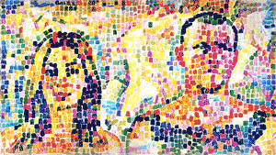
Deep Learning
source: http://bit.ly/2jcquh5
The next step in AI

Slide 25
Deep learning
Vast and sophisticated ANN structure
Tens, hundreds, thousands… of hidden layers
Ability to not only map the input to the output but recognize what inputs are needed for the task

Slide 26
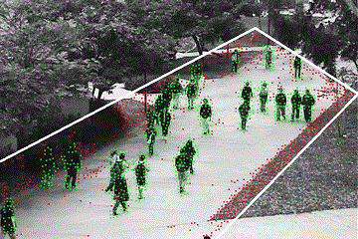
(Automated) Feature learning
Determine which features to use for a given task
Ability to (implicitly) perform feature transformations and dimensionality reduction
Automated feature engineering and learning eliminates the need for human intervention
source: http://bit.ly/2jwytoN

Slide 27
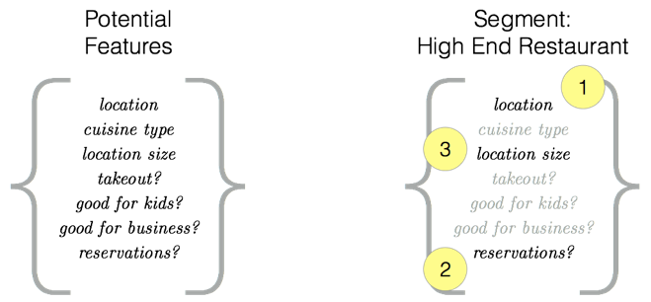
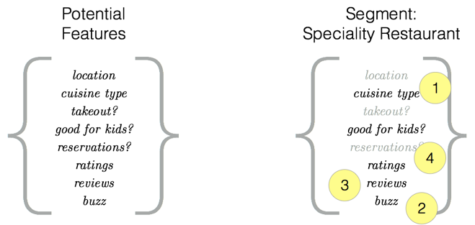
In practice
High-end restaurant
Key features are often related to location, ability to make reservations for large parties, and diversity of wine list
Specialty restaurant
Focus is on the reviews, ratings, social media buzz, and possibly if the restaurant is good for kids

Slide 28

TensorFlow
source: http://bit.ly/2itbqJT
Technology from Google

Slide 29
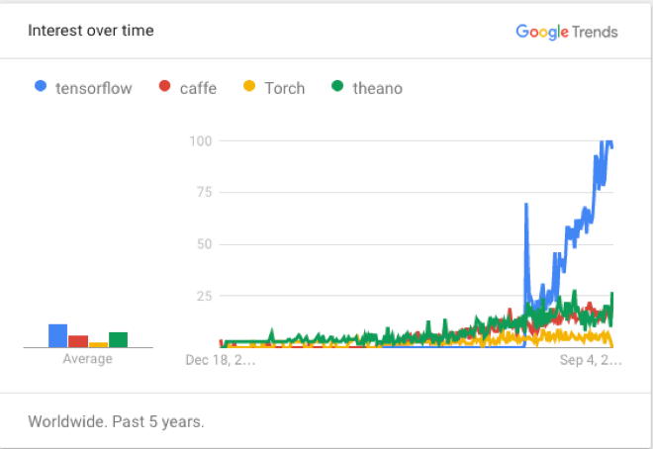
What is TensorFlow
Open source software library for numerical computation using data flow graphs
Based loosely on neural networks
Built in C++ with a Python interface
Quickly gained high popularity
Supports GPU computations

Slide 30
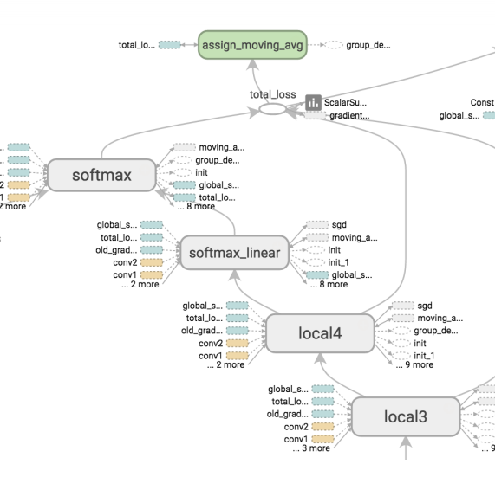
Data Flow Graph
Nodes represent mathematical operations
Edges are multidimensional arrays (tensors)
Thus, TensorFlow is a flow of multidimensional arrays (tensors) between the mathematical operations (nodes)

Slide 31
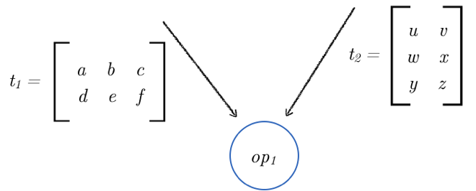
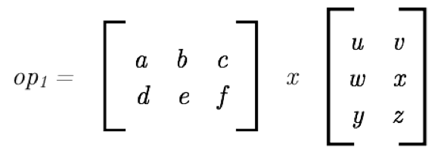
Concept
t1 is a 2x3 matrix
t2 is a 3x2 matrix
The op1 is a multiplication operator
The above can be represented in a matrix form
*

Slide 32
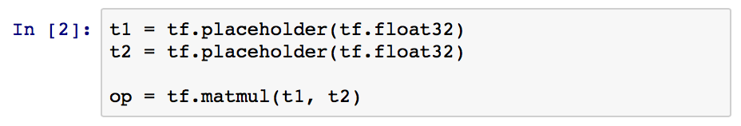
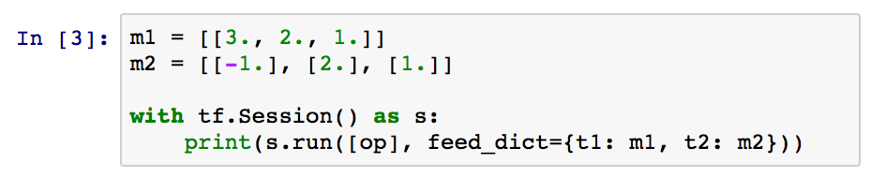
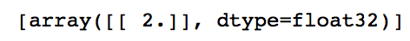
Example (pure Python)
Import TensorFlow
Prepare the tensors and operator
Feed the data
And get…

Slide 33
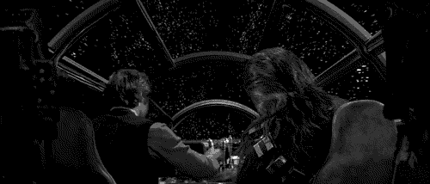
TensorFrames (experimental)
source: http://bit.ly/2jRN1mj
Built for speed!

Slide 34
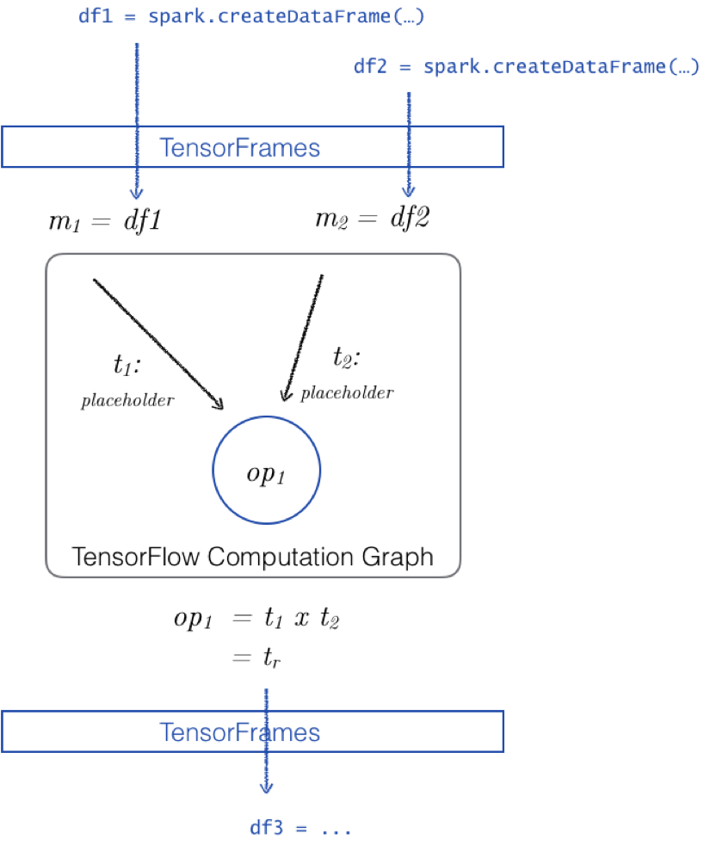
An intermediary
TensorFrames are built for speed*
Spark DataFrames as input
TensorFrames act as a bridge
Can return a DataFrame
* http://bit.ly/2iVy8vm
Notes:
Massive speed ups reported http://bit.ly/2iVy8vm

Slide 35
Getting ready
From CLI run
$SPARK_HOME/bin/pyspark \
--packages databricks:tensorframes:0.2.3-s_2.10
or (preferred) in Free Community Edition on Databricks start with
%sh
/databricks/python/bin/pip install https://storage.googleapis.com/tensorflow/linux/cpu/tensorflow-0.9.0rc0-cp27-none-linux_x86_64.whl
Notes:
Once the above installed on Databricks detach and reattached your cluster

Slide 36
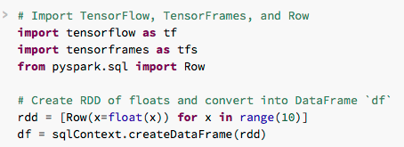
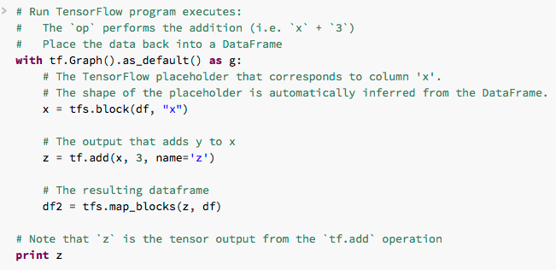
Start!
Import modules
Create some fake data
Create the graph
Block the variable
Add 3 to x and put in z
Return as df2

Slide 37
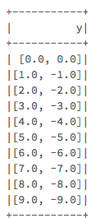
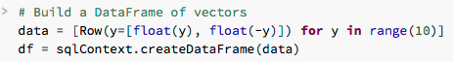
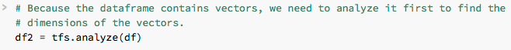
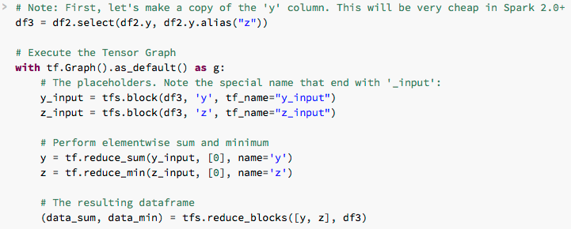
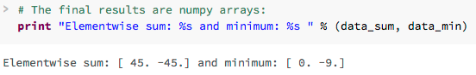
Element-wise sum and min
Create a DataFrame of lists
Analyze
Copy y
Create graph
Block the variables
Create the nodes
Get the results back

Slide 38
Tutorial Setup

Slide 39
Tutorial Prerequisites
Log into Databricks Community Edition (https://community.cloud.databricks.com)
Import notebooks: https://aka.ms/pydata-sea-2017-tfs
Start cluster
Install libraries
Let’s go!

Slide 40
Import Notebooks
Steps to Import notebooks
Repeat

Slide 41
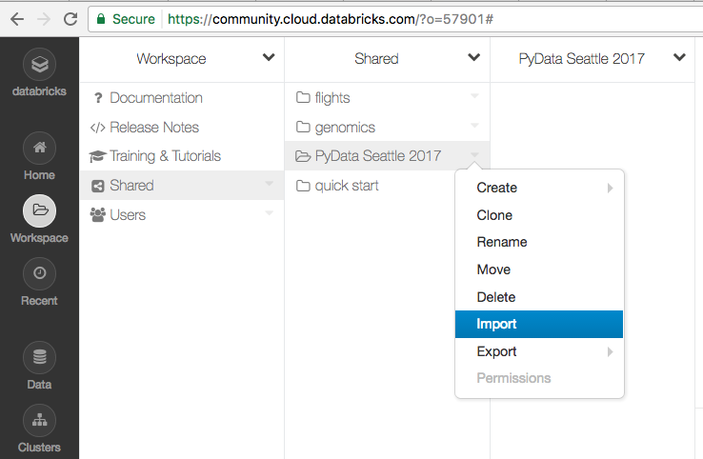
Import notebook

Slide 42
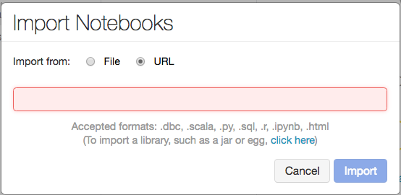
Import Notebook Dialog

Slide 43
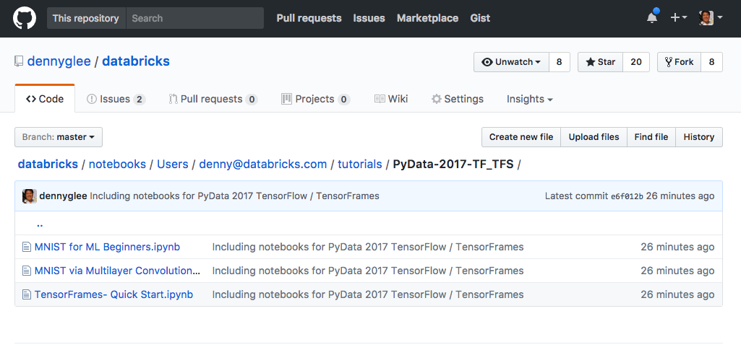
Goto https://aka.ms/pydata-sea-2017-tfs

Slide 44
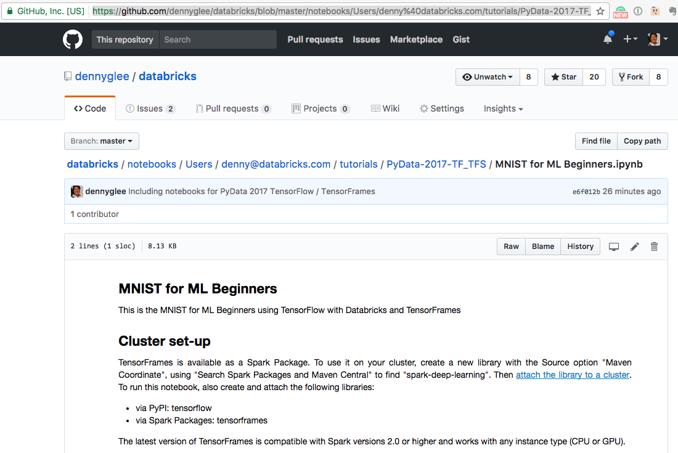
Open a notebook > Get URL

Slide 45
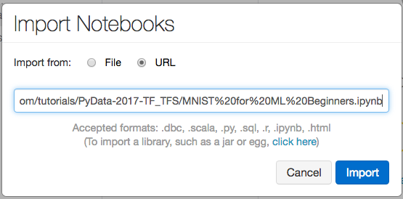
Paste URL into Import Notebooks dialog

Slide 46
Do it for all three notebooks

Slide 47
Start a cluster
Three steps to start a Spark cluster

Slide 48
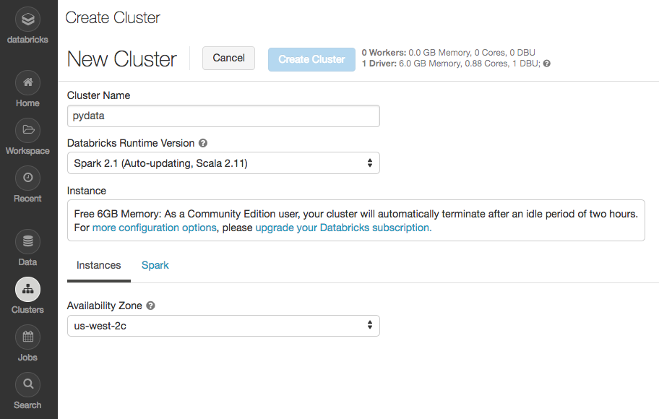
Start a cluster
Clusters > Create Cluster
Fill in name and Run-time version: Spark 2.1 (Scala 2.11)

Slide 49
Install libraries
Installing TensorFlow via PyPi
Installing TensorFrames via Spark Packages

Slide 50
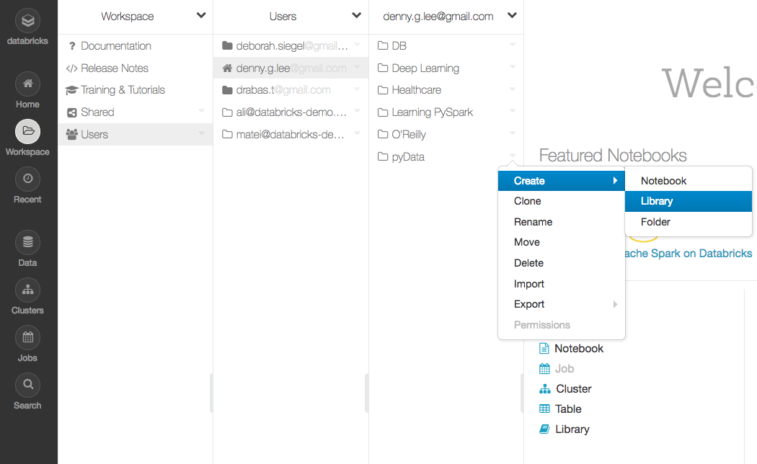
Create Library

Slide 51
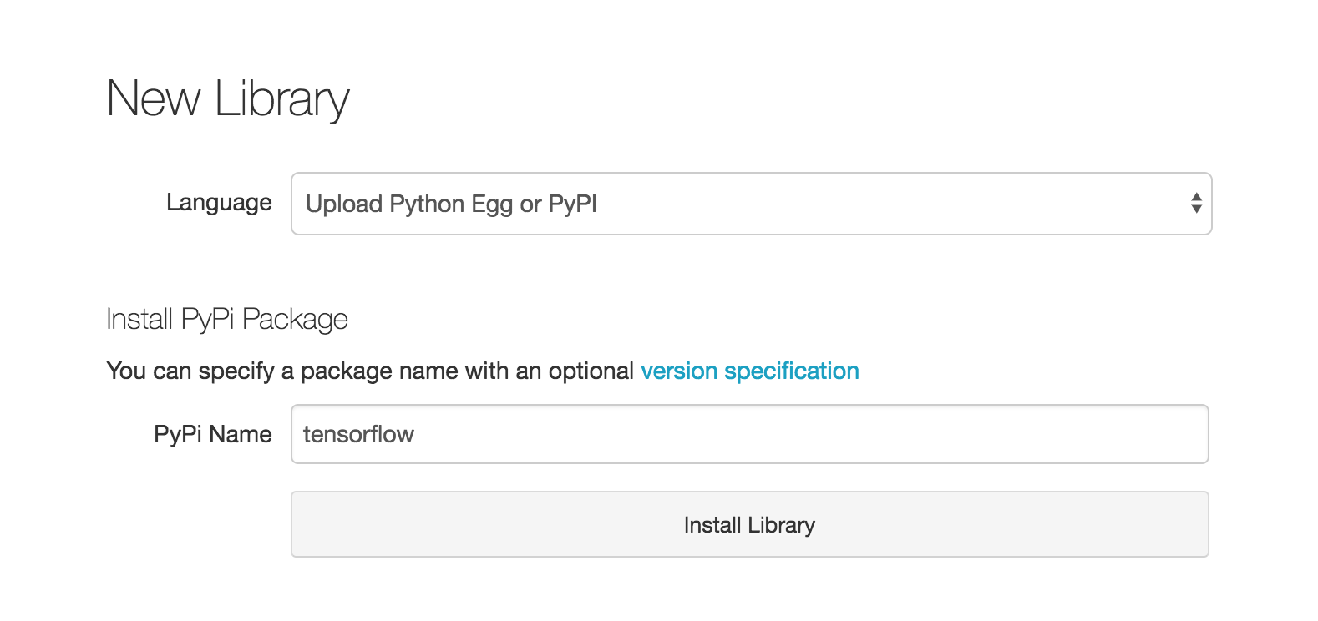
Install TensorFlow via PyPi

Slide 52

Attach TensorFlow to your cluster

Slide 53

Install TensorFrames via Spark Packages

Slide 54

Find TensorFrames

Slide 55

Create TensorFrames Library … Almost!

Slide 56

Attach TensorFrames Library

Slide 57
Let’s go!

Slide 58
Handwritten Digit Recognition

Slide 59
Need to update slides below to reflect TensorFlow Need to add TensorFrames slides too

Slide 60

Handwritten Digit Recognition
Source: http://bit.ly/2sbFW0R

Slide 61
MNIST Data
Set of handwritten digits based on the National Institute of Science and Technology – i.e. a modified dataset or MNIST dataset – via LeCun et. al
Original source is NIST Special Database 19 Handprinted Forms and Characters Database comprised of:
Images: Each digit is a scanned 28px x 28px flattened into an array of size 784
Labels: One-Hot vector representing the actual number associated with the image

Slide 62
Notebook configuration
%%configure -f
{
"jars": ["wasb:///bigdl-0.2.0-SNAPSHOT-jar-with-dependencies.jar"],
"conf":{
"spark.executorEnv.DL_ENGINE_TYPE": "mklblas",
...
}
}
Include the BigDL fat JAR
Use the Intel Math Kernel Library (MKL)
Basic Linear Algebra Subprograms (BLAS)

Slide 63
BigDL Engine Initialization
Engine.init(nodeNumber, coreNumber, true)
This is used in the notebook
spark-shell --properties-file dist/conf/spark-bigdl.conf ...
This is used in spark-shell / pyspark

Slide 64
CNN Structure
Source: http://bit.ly/2suMHKL

Slide 65
CNN Structure: Input layer
The Input layer is specified by the Reshape(...) method: it takes an image as a input and reshapes the input image to 28x28 matrix (in case it was of a different size).
Source: http://bit.ly/2suMHKL

Slide 66
CNN Structure: Convolution layer C1
The Convolution layer 1 with kernel 5x5 is implemented as a SpatialConvolution(...). The first parameter is the number of input dimensions (in our case 1 as we process one image at a time). We will output 6 planes that measure 24x24 (Why? Tip: 5x5 and the 28x28 size of the input.) What we are training in this part of the network is the kernel structure. The last two parameters specify size of the kernel (note: the kernels should have odd-numbered dimensions e.g. 3x3 or 7x7 -- why?). The outputs from the kernels are then squashed using the Tanh() function so the values are in the <−1;1><−1;1> range.
Source: http://bit.ly/2suMHKL

Slide 67
CNN Structure: Pooling layer S1
The Pooling layer 1 is added using the SpatialMaxPooling(...) method. The pooling scans through the outputs of the convolutional layer 1 and averages the output given the kernel size. The first two parameters specify the kernel width and height, the remaining two specify the horizontal and vertical step size. The outputs from this layer are again squashed using the Tanh() function.
Source: http://bit.ly/2suMHKL

Slide 68
CNN Structure: Convolution layer S2
The Convolution layer 2 with kernel 5x5 is implemented in a much similar fashion: we again use the 5x5 kernel, we take the 6 outputs from the Pooling layer 1 and output 12 matrices, each 8x8 in size.
Source: http://bit.ly/2suMHKL

Slide 69
CNN Structure: Pooling layer S2
The Pooling layer 2 brings the outputs from the preceding stage down to 4x4 in size as we, again, use the 2x2 kernels.
Source: http://bit.ly/2suMHKL

Slide 70
CNN Structure: Linearizing layer
The Linearizing layer starts with reshaping the output of the final pooling layer into a 1-dimensional array of 192 elements. Next, we add a fully-connected Linear(...) layer that uses a linear function y =Wx + b (W stands for the matrix of weights and b is bias). The layer takes the 192 element output from the pooling layer and outputs a 100 values that are being once again squashed by the Tanh() function. The last linear layer reduces the number of outputs to 10 - the number of the digits we try to recognize.
Source: http://bit.ly/2suMHKL

Slide 71

CNN Structure: Output layer
Finally, the LogSoftMax() layer assigns the digit probability to the input by using the following formula
Source: http://bit.ly/2suMHKL

Slide 72

Load MNIST Data
def load(...): Array[ByteRecord] = {
...
require(labelMagicNumber == 2049)
...
require(featureMagicNumber == 2051)
...
result
}

Slide 73
Normalizing the MNIST data
Normalization changes the range of pixel intensity
Also known as contrast stretching or histogram stretching
Bring image values to the same range
val trainMean = 0.13066047740239506
val trainStd = 0.3081078
val trainSet = DataSet.array(load(trainData, trainLabel), sc) -> BytesToGreyImg(28, 28) -> GreyImgNormalizer(trainMean, trainStd) -> GreyImgToBatch(batchSize)

Slide 74
CNN Structure: Input layer
The Input layer is specified by the Reshape(...) method: it takes an image as a input and reshapes the input image to 28x28 matrix (in case it was of a different size).
Source: http://bit.ly/2suMHKL

Slide 75
Why normalize?
“CNNs learn by continually adding gradient error vectors (multiplied by a learning rate) computed from backpropagation to various weight matrices throughout the network as training examples are passed” [Source: http://bit.ly/2rsc2b1]

Slide 76
Why normalize? (continued)
“If we don’t scale our input training vectors, the ranges of distribution of those feature vectors would likely be different for each vector – i.e. learning rate would cause corrections, e.g. over compensating one and under compensating another” [Source: http://bit.ly/2rsc2b1]

Slide 77

LeNet-5, convolution neural networks
Convolution Neural Networks (CNNs)
Special type of multi-layer neural network
Trained with a version of back-propagation algorithm
CNNs designed to recognize visual patterns with minimal preprocessing
Can recognize patterns with extreme variability
LeNet-5 is the baseline CNN for MNIST data
Source: http://yann.lecun.com/exdb/lenet/

Slide 78
Training LeNet model
val initialModel = buildModel(10)
val optimizer = Optimizer(
...
)
val trainedModel = optimizer.setValidation(
...
)
10 digit class
Optimizer represent a optimization process,
aka training.
Validate the model using the validation dataset

Slide 79
Validating the model
val validator = Validator(trainedModel, validationSet)
val result = validator.test(Array(new Top1Accuracy[Float]))
Validate the accuracy of this model – i.e. 98.78%

Slide 80
Q&A

